Slide 1
RGB COLOR SENSOR PROJECT Team Sagittarius
Progress and summary until week 2

Slide 2
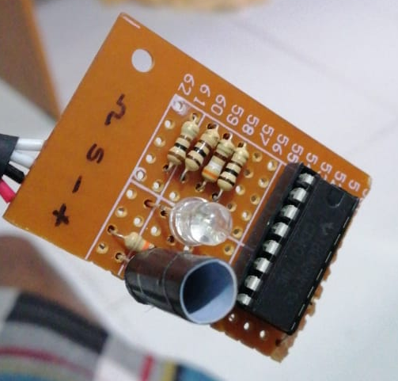
Two basic ideas for the sensing part
Using one LDR & RGB LED
(Later found out as not the best method)
RBG LED
Idea was that object of a given color X, reflects most of the X color light while absorbing most of the other colors.
Therefore, if we can detect the amount of reflection for each Red, Green and Blue light we can roughly estimate the color-composition of the given object.
LDR
(covered to avoid background noise)
But practically, even with proper calibration we were not able to detect some reddish-colors (pink, orange) in an appreciable manner. So, we sticked to our next idea.

Slide 3
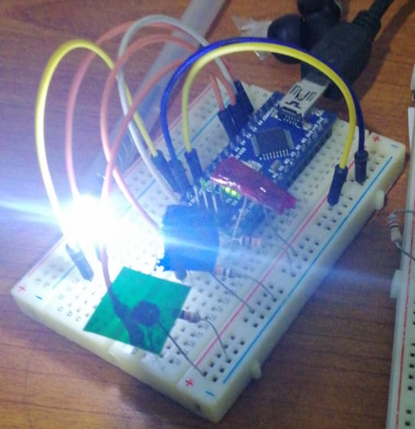
Two basic ideas for the sensing part (contd.)
Using one white LED and 3 LDRs with RBG filters
(Selected to implement, because results were accurate enough!)
Each color filter lets pass only one main color (R,G or B).Therefore, using each LDRs resistance values at a given time we can measure
the amount of each color reflected from the object.
After experimenting with several calibration procedures, we could detect both primary colors and secondary colors accurately.
White LED
By visualizing the almost equal color of the object (on the screen), we verified that the sensor is working correctly.
LDR with
Red filter
LDR with
Green filter
LDR with
Blue filter

Slide 4
Problems came on the way
Here we are focused on the problems we experienced in the selected prototype
Filters used for each LDR was not doing the filtering process equally
(The amount of passing of light per each color in each filter was different due to selecting
various materials and thicknesses of filters.)
We are experimenting for a proper filter material and accurate calibration technique.
To connect the keypad, we had to use 7 pins leaving us only one pin for other tasks
Using resistors and implementing another circuit we were able to connect keypad with only one analog pin

Slide 5
Problems came on the way (Contd.)
Connecting the display uses 6 pins
i2c protocol
Using only one PWM pin to control the OUTPUT LED

